Slide 1
NGS Bioinformatics Overview
Joshua Randall
Human Genetics Informatics
Wellcome Trust Sanger Institute
Thanks to Thomas Keane and Harold Swerdlow for some slide content

Slide 2
NGS Bioinformatics Overview
NGS Overview
NGS Analysis Workflows
NGS Data Formats
Lab Exercises

Slide 3


Capillary Sample Prep
Fragment genome
Clone into
bacterial vector
Grow and purify

Slide 4
Next-Generation Sample Prep
[Amplify] fragments directly on a surface (bead, chip, etc.)

Slide 5
Capillary Sequencing
Prime
Extend
with A,C,G,T terminators
AACGT . . .
Separate by size and detect

Slide 6

Sequencing by Synthesis
Extend by 1 base
Image
Reverse termination
Repeat

Slide 7
Capillary Reactions
1 tube
1 template
1 capillary
1000 bases

Slide 8

Next-Generation Reactions
1 feature
1 template
1 chip
gigabases

Slide 9
De-novo Sequencing
Long shotgun reads
Assemble
Gap fill
Finished sequence

Slide 10
Re-sequencing
Short reads
Align to reference
Call variants

Slide 11
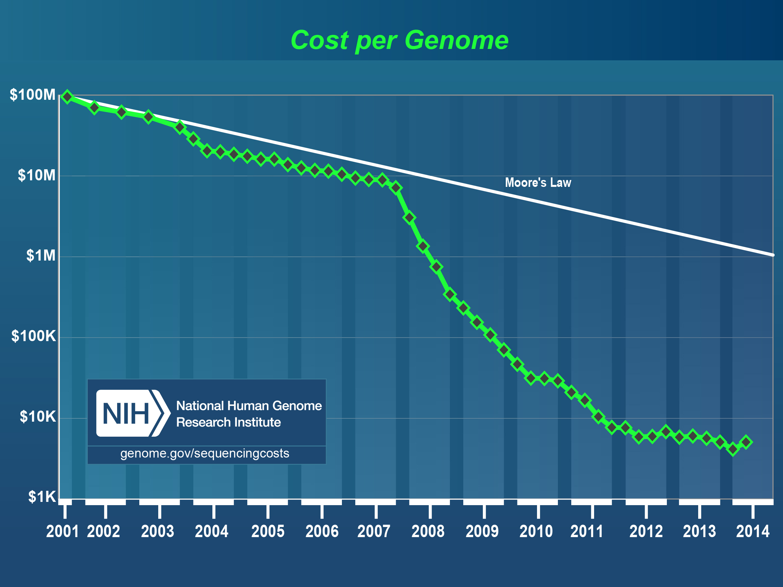
Global Sequencing Progress
Capillary
NGS

Slide 12
NGS Process
DNA Prep
Library Prep
Chip Prep
Sequencing
Analysis

Slide 13
NGS Bioinformatics Overview
NGS Overview
NGS Analysis Workflows
NGS Data Formats
Lab Exercises

Slide 14
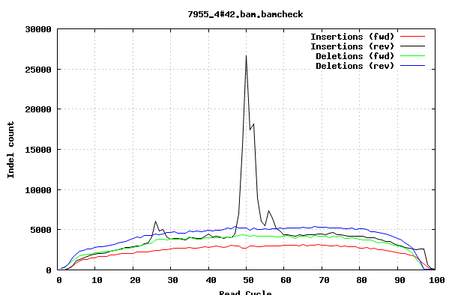
NGS Workflows
Next-gen sequencing experiments:
Vary from one or two up to thousands of samples
Can generate one or more sequencing libraries per sample
Multiple libraries can be sequenced per lane (multiplex)
We call data from one index within a lane a ‘lanelet’
Data can be quite large
can be difficult to do even ‘easy’ things like splitting and merging
Major modes: de-novo assembly or reference-based analysis
In resequencing, alignment of reads onto reference is just the 1st step
QC of data is very important for good calls
Biases in the library or sequence data will produce unexpected results or missed variant calls (e.g. GC or context bias)
False indels due to ‘bubbles’ in sequencing run

Slide 15
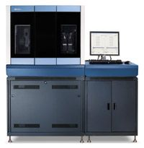
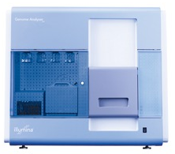
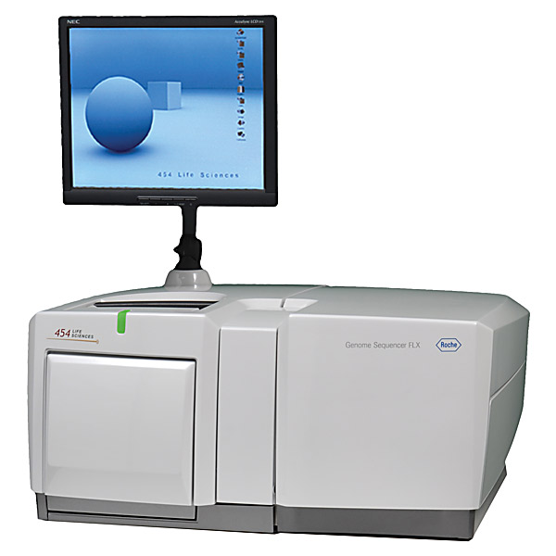
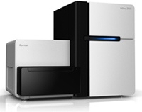
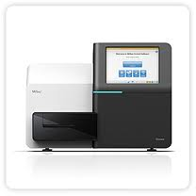
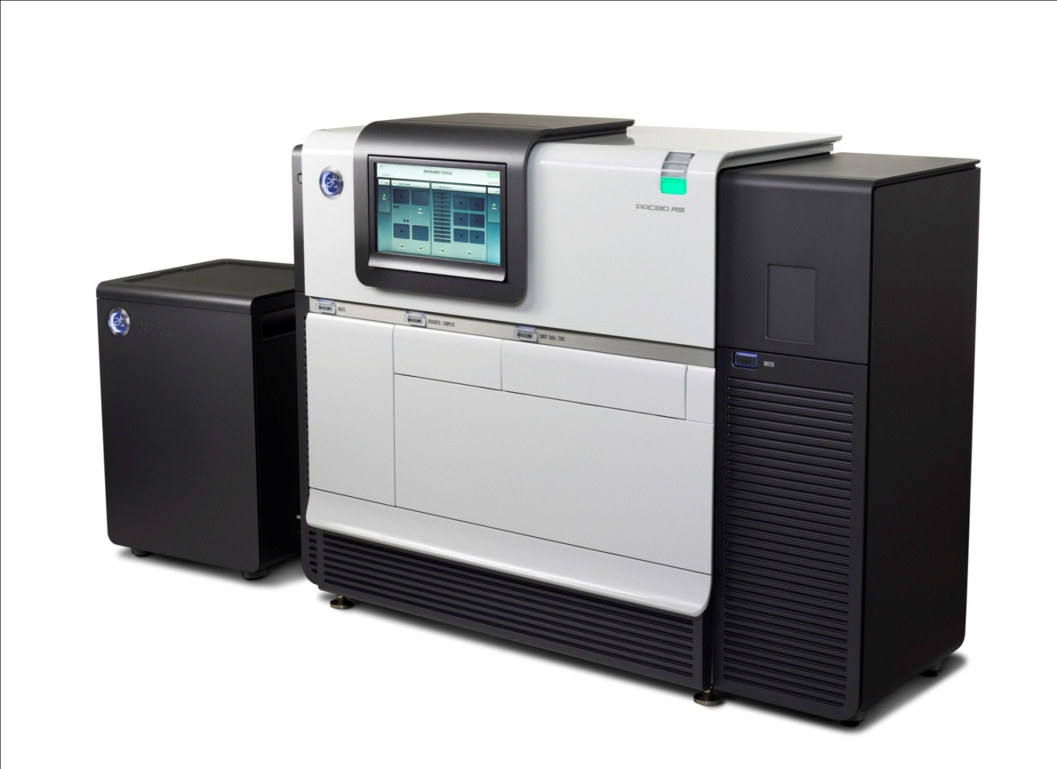
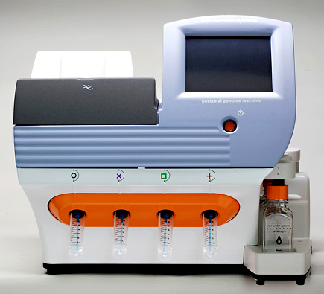
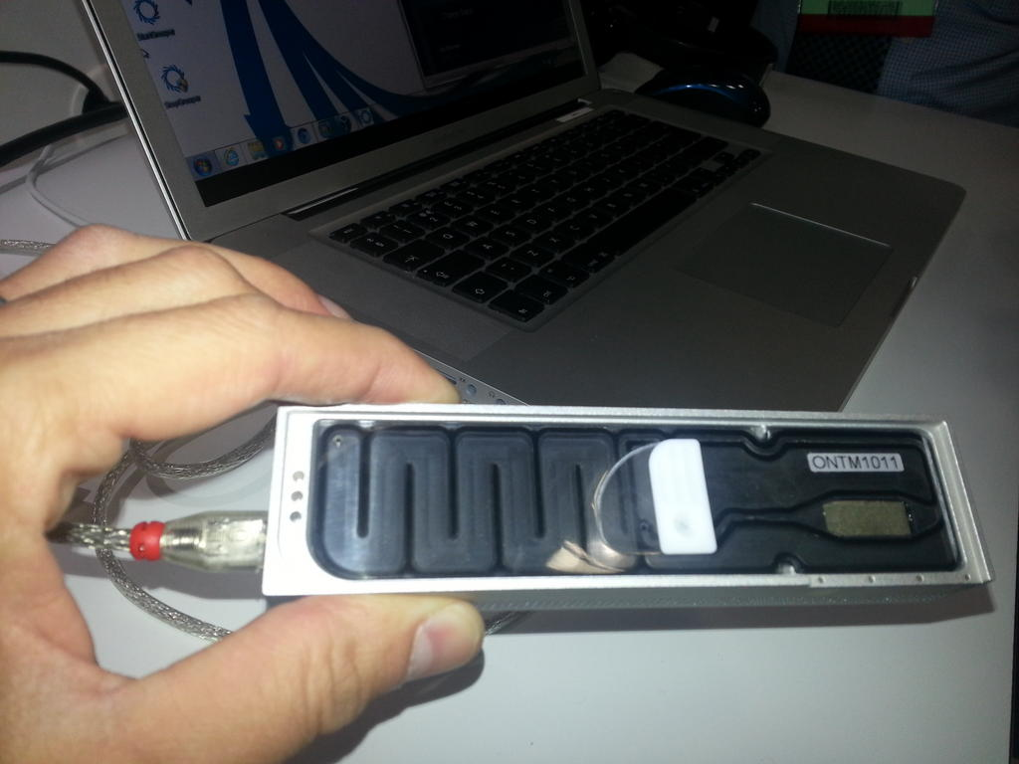
Resequencing Data Production Workflow
Merge Up
Sample/Platform
Sample
merge
NA34842
NA87465
Library
merge
BAM
BAM
BAM
Library
Freeze
Alignment
+
Improvement
BAM
BAM
BAM
……
BAM
BAM
BAM
Improvement
BAM
BAM
BAM
……
BAM
BAM
Alignment
(bwa, smalt etc)
Fastq
Fastq
……
Fastq
Fastq
Notes:
Now I will talk about the typical workflow used to process experiments involving large number of samples, libraries, lanes/plexes; prior to variant calling. We use this workflow to process 1000 genomes, UK10K, mouse sequencing….cancer sequencing etc.
Obtain sequencing data from the WTSI core facility and via disk shipments from the BGI.
BAM improvement: recalibration of base qualities and realignment around known indel sites

Slide 16
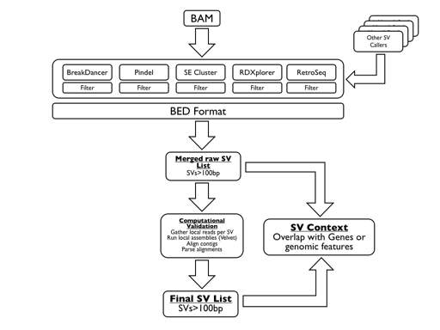
Resequencing Data Production Workflow
Chr1
Chr2
Chr3
NA19294
NA18943
NA19305
.
.
NA19309
…
…
Merge
across
.
.
.
.
.
.
.
.
.
…
RG:NA19294
RG:NA18943
RG:NA19305
Cross-sample BAMs
SNPs/indels
SVMerge
Variant
Calling
samtools
GATK
Genome STRiP
VQSR
BEAGLE/Impute2
VEP Annotation
Final VCF ☺
Notes:
We have sample level BAM files – we could go straight to variant calling but as numbers of samples increased we had scaling issues with open huge number of BAM files simultaneously.
Merge across to create vertical chromosome BAMs (multiple samples per BAM per chromosome - ~100 samples)
-> reduce the number of file handles when doing variant calling
-> RG tags MUST be annotated
How variant callers are run obviously depends on the experiment

Slide 17
NGS Bioinformatics Overview
NGS Overview
NGS Analysis Workflows
NGS Data Formats
Lab Exercises

Slide 18

Raw NGS Data
Small region of an Illumina image file (one per read cycle)

Slide 19

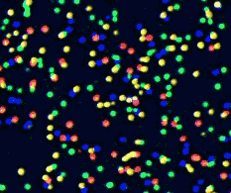
Raw NGS Data
Illumina image data: zoomed in to reveal individual clusters
A C
G T
20 MICRONS
100 MICRONS

Slide 20









Base calling from raw Illumina data
T
TG
TGC
T G C T A C G A T …
1
2
3
4
5
6
7
8
9
T T T T T T T G T …
Base calling is now done in real-time (Illumina RTA) and raw images are typically discarded once calling is complete. Illumina RTA output includes a sequence of bases for each read, along with quality scores for each base. It can be exported to FASTQ or converted directly to unaligned BAM.

Slide 21
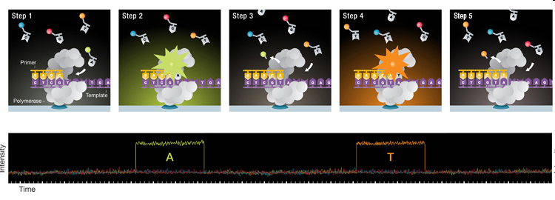
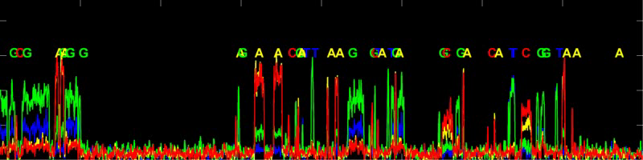
Raw PacBio data

Slide 22
Primary NGS Data Formats
FASTA
Unaligned sequence data (in NGS context, used only for reference data)
FASTQ
Unaligned read sequences with base qualities
BAM
Aligned or unaligned reads
Text and binary formats
CRAM
Aligned or unaligned reads
Advanced compression models
VCF
Flexible variant call format
Arbitrary types of sequence variation

Slide 23
FASTA
FASTA is a simple format for raw sequencing data
In NGS workflows, typically only used for reference data
File extension is normally .fasta or .fa
Format
File can contain any number of sequence sections
Each sequence starts with a single-line description beginning with the ‘>’ character
Following this come any number of lines consisting of sequence data which when concatenated together gives the full sequence
Cock et al. (2009) NAR

Slide 24
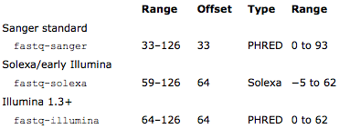
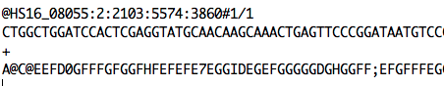
FASTQ
FASTQ is a simple format for raw unaligned sequencing reads
Simple addition to the FASTA format
Sequence and an associated per base quality score
Originally standard for storing capillary data
Format
Subset of the ASCII printable characters
ASCII 33–126 inclusive with a simple offset mapping
perl -w -e "print ( unpack( 'C', '%' ) - 33 );”
Cock et al. (2009) NAR

Slide 25
SAM/BAM Format
SAM (Sequence Alignment/Map) format
Single unified format for storing read alignments to a reference genome
BAM (Binary Alignment/Map) format
Binary equivalent of SAM
Developed for fast processing/indexing
Advantages
Can store alignments from most aligners
Supports multiple sequencing technologies
Supports indexing for quick retrieval/viewing
Compact size (e.g. 112Gbp Illumina = 116Gbytes disk space)
Reads can be grouped into logical groups e.g. lanes, libraries, samples
Widely support by variant calling software packages
Replacement for SRF & FASTQ

Slide 26
Read Entries in SAM
No. Name Description
1 QNAME Query NAME of the read or the read pair
2 FLAG Bitwise FLAG (pairing, strand, mate strand, etc.)
3 RNAME Reference sequence NAME
4 POS 1-Based leftmost POSition of clipped alignment
5 MAPQ MAPping Quality (Phred-scaled)
6 CIGAR Extended CIGAR string (operations: MIDNSHP)
7 MRNM Mate Reference NaMe (‘=’ if same as RNAME)
8 MPOS 1-Based leftmost Mate POSition
9 ISIZE Inferred Insert SIZE
10 SEQ Query SEQuence on the same strand as the reference
11 QUAL Query QUALity (ASCII-33=Phred base quality)
HS18_07983:1:2203:5095:109107#36 163 ENA|AJ011856|AJ011856.1 412 60 100M = 471 159
ATAAAATTATTAATAATAATCAATATGAAATTAATAAAAATCTTATAAAAAAGTAATGAATACTCCTTTTTAAAAATAAAAAGGGGTTCGGTCCCCCCCC
9BCDGDEHGEHFHHGFHHJGHFHIGHFIGHFHGGGHGHGHGHJGHHGHHHGGHHHIGGGGGFGGDGGHFHFIGEGHGFGGHFEDGG4GHGGGFHGFHIEF
X0:i:1 X1:i:0 MD:Z:100 RG:Z:1#36.1
Heng Li et al (2009) The Sequence Alignment/Map format and SAMtools, Bioinformatics, 25:2078-2079

Slide 27
Cigar Format
Cigar has been traditionally used as a compact way to represent a sequence alignment
Operations include
M - match or mismatch
I - insertion
D - deletion
SAM extends these to include
S - soft clip (ignore these bases)
H - hard clip (ignore and remove these bases)
E.g. Read: ACGCA-TGCAGTtagacgt
Ref: ACTCAGTG—-GT
Cigar: 5M1D2M2I2M7S

Slide 28
What is the cigar line?
E.g. Read: tgtcgtcACGCATG---CAGTtagacgt
Ref: ACGCATGCGGCAGT
Cigar:
Notes:
7S7M3D4M7S

Slide 29
Read Group Tag
Each lane has a unique RG tag that contains meta-data for the lane
RG tags
ID: SRR/ERR number
PL: Sequencing platform
PU: Run name
LB: Library name
PI: Insert fragment size
SM: Individual
CN: Sequencing center

Slide 30
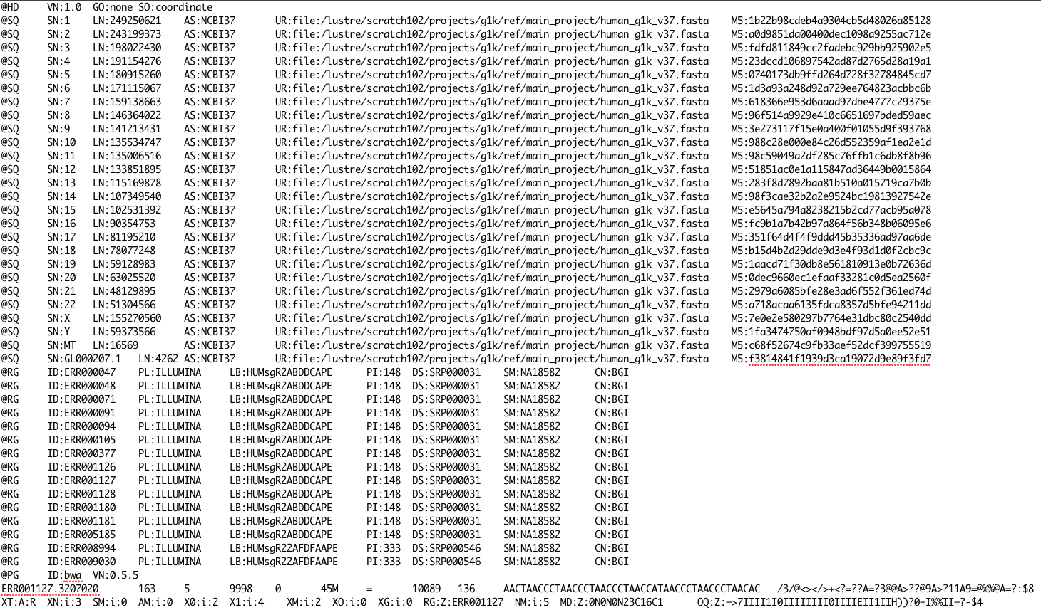
1000 Genomes BAM File
samtools view –h mybam.bam | less -S

Slide 31
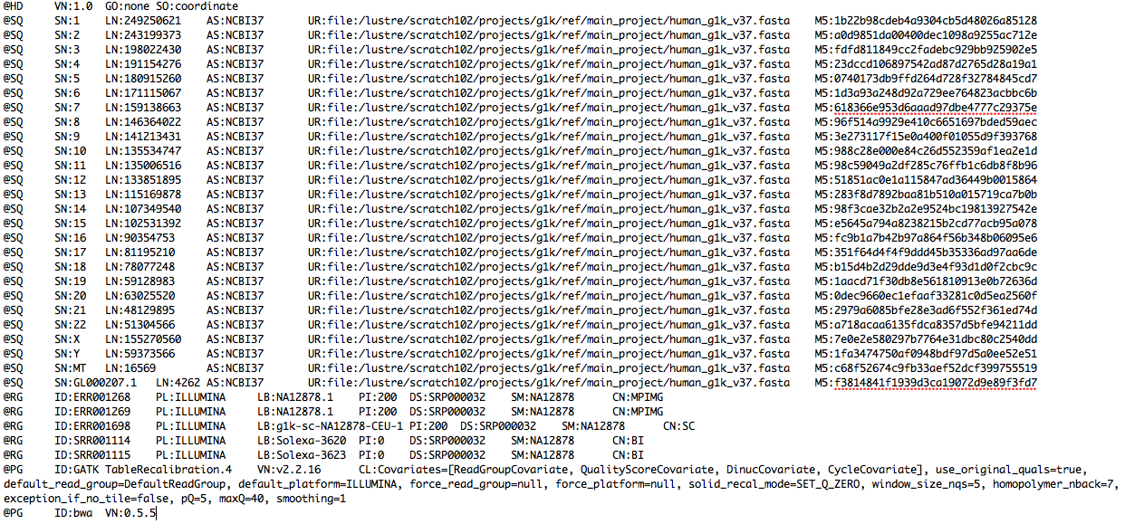
1000 Genomes BAM File
samtools view –H my.bam | less -S
How is the BAM file sorted? How many different sequencing centres contributed lanes to this BAM file? What is the alignment tool used to create this BAM file?
How many different sequencing libraries are there in this BAM? Hint: RG tag

Slide 32
SAM/BAM Tools
Several tools and programming APIs for interacting with SAM/BAM files
Samtools - Sanger/C (http://htslib.org/)
Convert SAM <-> BAM (samtools view)
Sort and index BAM files (samtools sort, samtools index)
Give summary of the mapping flags (samtools flagstat)
Merge multiple sorted BAM files (samtools merge)
Remove PCR duplicates from the library preparation (samtools rmdup)
Picard - Broad Institute/Java (http://picard.sourceforge.net)
MarkDuplicates, CollectAlignmentSummaryMetrics, CreateSequenceDictionary, SamToFastq, MeanQualityByCycle, FixMateInformation, … (and many others)
Pysam – Python library based on htslib (http://code.google.com/p/pysam/)
BAM Visualisation
Samtools (samtools tview): http://htslib.org/
BamView, LookSeq, Gap5: http://www.sanger.ac.uk/resources/software/
IGV: http://www.broadinstitute.org/igv/
Tablet: http://bioinf.scri.ac.uk/tablet/
PyBamView: http://melissagymrek.com/pybamview/

Slide 33
CRAM
BAM files are large
~1.5-2 bytes per base pair (12-16 bits/bp)
Increases in disk capacity are being far outstripped by sequencing technologies (per unit cost of each)
BAM stored all of the data
every read base
every base quality
using conventional compression techniques
CRAM: Two important concepts
Reference based compression
Controlled loss of quality information
Supported by samtools (and htslib) – htsjdk support in development

Slide 34
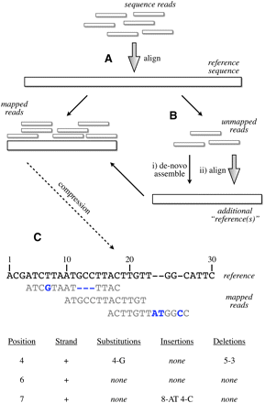
Reference Based Compression
Fritz et al. (2012) Gen Res
Notes:
Figure 1.
Schematic of the compression technique. (A) Reads are first aligned to an established reference. (B) Unaligned reads are then pooled to create a specific “compression framework” for this data set. (C) The base pair information is then stored using specific offsets of reads on the reference, with substitutions, insertions, or deletions encoded in separate data structures.

Slide 35
CRAM: Reference-based sequence data compression
TGAGCTCTAAGTACC
329183050298757
CRAM models for compression
TGAGCTCTAAGTACC
TGAGCTCTAAGTACC
002020010022212
-2---30---9---7
Do nothing
Lossless
Horizontal
Vertical
Quality lossy
Bits/base
CRAM current performance
Untreated
CRAM lossless
CRAM combination model
CRAM substitutions/insertions model
CRAM v0.9 released 03.08.12:
Pairing information preservation regardless of distance
Revised and improved lossless mode
Option to preserve all unmapped reads
Performance and bug fixes
Arbitrary tags
http://www.ebi.ac.uk/ena/about/cram_toolkit
http://listserver.ebi.ac.uk/mailman/listinfo/cram-dev
35
28/09/15
European Nucleotide Archive

Slide 36
Variant Call Format (VCF)
VCF is a standardised format for storing DNA polymorphism data
SNPs, insertions, deletions and structural variants
With rich annotations
Can be indexed for fast data retrieval of variants from a range of positions
Store variant information across many samples
Record meta-data about the site
dbSNP accession, filter status, validation status
Very flexible format
Arbitrary tags can be introduced to describe new types of variants
No two VCF files are necessarily the same
User extensible annotation fields supported
Same event can be expressed in multiple ways by including different numbers
Recommendation on VCF format website to ensure consistency

Slide 37
VCF file structure
Header section and a data section
Header
Arbitrary number of meta-information lines
Starting with characters ‘##’
Column definition line starts with single ‘#’
Mandatory columns
Chromosome (CHROM)
Position of the start of the variant (POS)
Unique identifiers of the variant (ID)
Reference allele (REF)
Comma separated list of alternate non-reference alleles (ALT)
Phred-scaled quality score (QUAL)
Site filtering information (FILTER)
User extensible annotation (INFO)

Slide 38
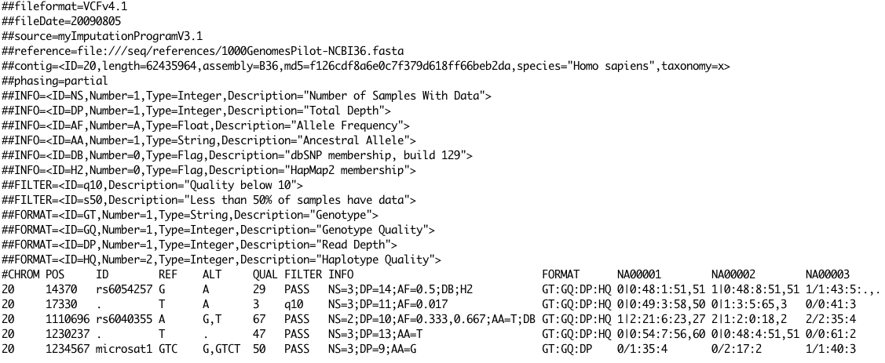
Example VCF – SNPs/indels
Notes:
This example shows in order a good simple SNP, a possible SNP that has been filtered out because its quality is below 10, a site at which two alternate alleles are called, with one of them (T) being ancestral (possibly a reference sequencing error), a site that is called monomorphic reference (i.e. with no alternate alleles), and a microsatellite with two alternative alleles, one a deletion of 2 bases (TC), and the other an insertion of one base (T). Genotype data are given for three samples, two of which are phased and the third unphased, with per sample genotype quality, depth and haplotype qualities (the latter only for the phased samples) given as well as the genotypes. The microsatellite calls are unphased.

Slide 39
Indexing and compression
Text formats (VCF, SAM, FASTQ) can be block compressed
Using `bgzip` or built-in capability of other software (e.g. `samtools`)
Sorted, bgzip-compressed files can then be indexed with `tabix`
Using the index, software can access specific regions without having to stream through the full file
Other formats such as BAM, CRAM have their own indexing system (e.g. ‘.bai’, ‘.crai’, ‘.csi’) but work similarly

Slide 40
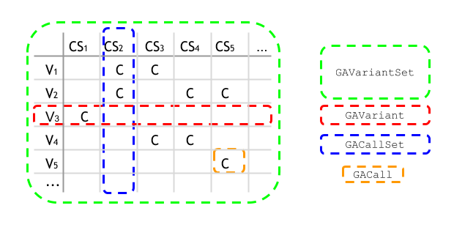
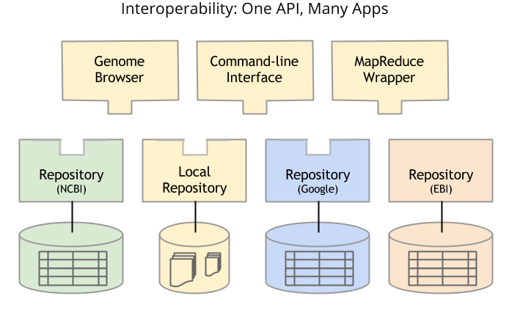
Future formats
API and data models are being developed and standardised by the Global Alliance for Genomics and Health (http://www.ga4gh.org/)

Slide 41
NGS Bioinformatics Overview
NGS Overview
NGS Analysis Workflows
NGS Data Formats
Lab Exercises

